Slide 1




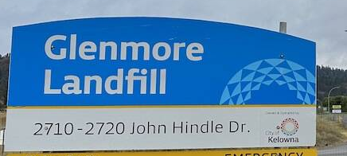








Summary of Facilities
2
1
Westside Residential Waste Disposal and Recycling Centre, 2640 Asquith Road
Glenmore Landfill, 2710 John Hindle Drive
Kelowna Recycling, 1972 Windsor Road
Habitat for Humanity, 2092 Enterprise Way
3
210 Lougheed Road
1465 Ellis Street
1505 Hardy Street
4
1650 Springfield Road
470 Highway #33 West
2515 Enterprise Way
2514 BC-97
1264 Ellis St
Downtown
Glenmore
Mission
Rutland
5
4

